Slide 1

CHOCOLATEY
Modern Software Automation
A presentation by Niklas Tinner

Slide 2

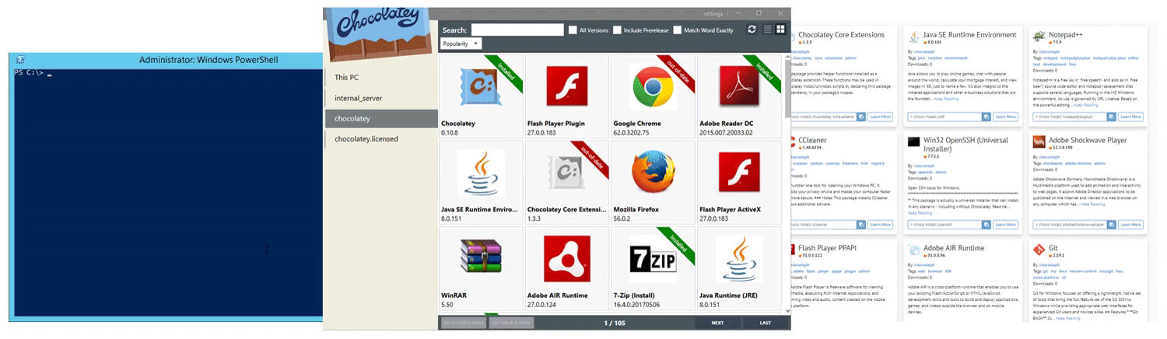
Package Manager for Windows

Slide 3
Repo types
public/community
Online - Default
Least effort / the modern way
private (internal network)
Use own repo as primary
Packages must be integrated manually
More control

Slide 4
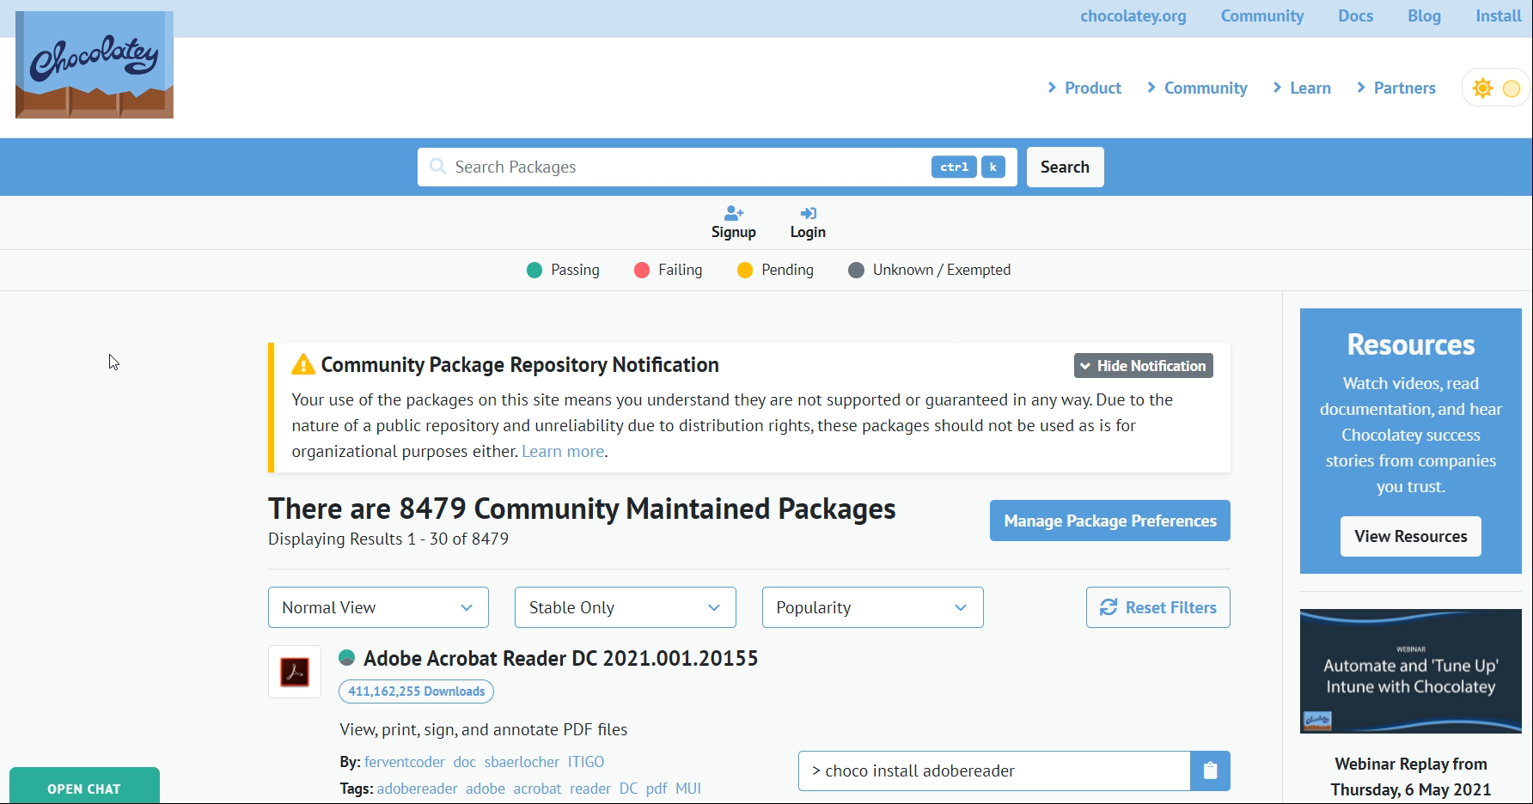
The public repository

Slide 5
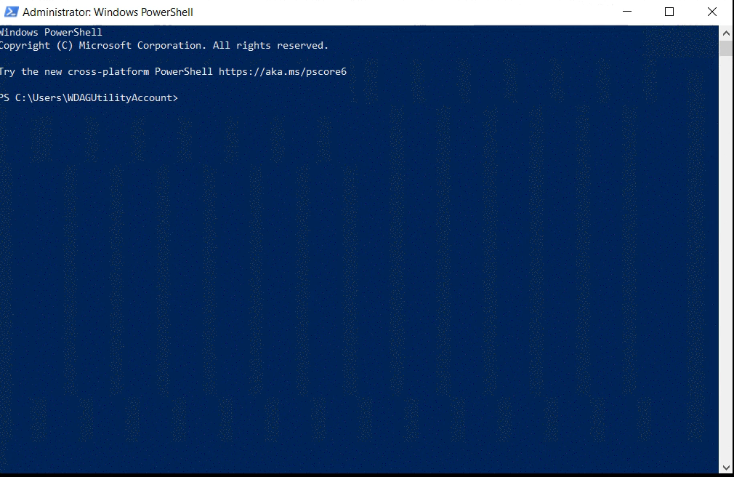
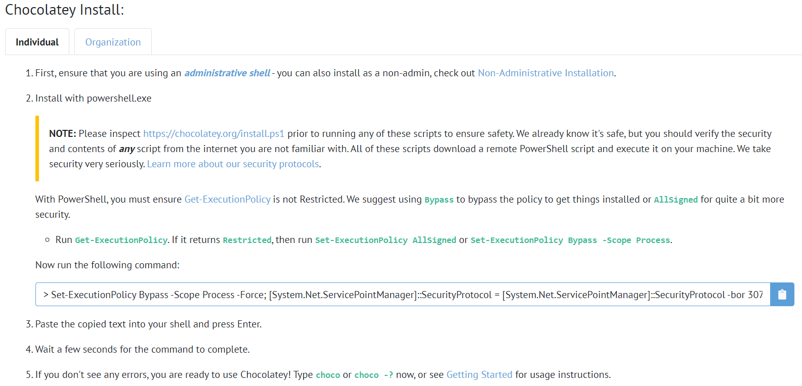
Install choco

Slide 6
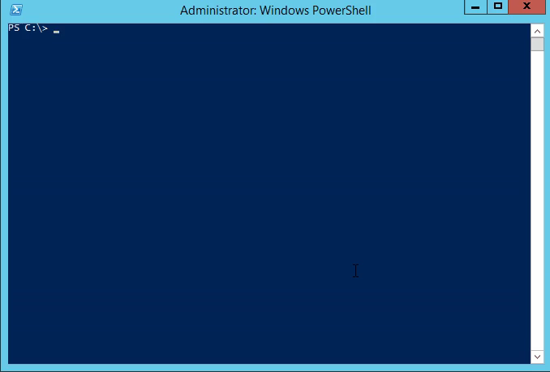
Powershell client {env:choco}

Slide 7
Choco apps client distribution in plain code
Install.ps1
Uninstall.ps1
$localprograms = choco list -localonly
if ($localprograms -like "*googlechrome*")
{
choco upgrade googlechrome -y
}
else
{
choco install googlechrome -y
}
choco uninstall googlechrome -y

Slide 8
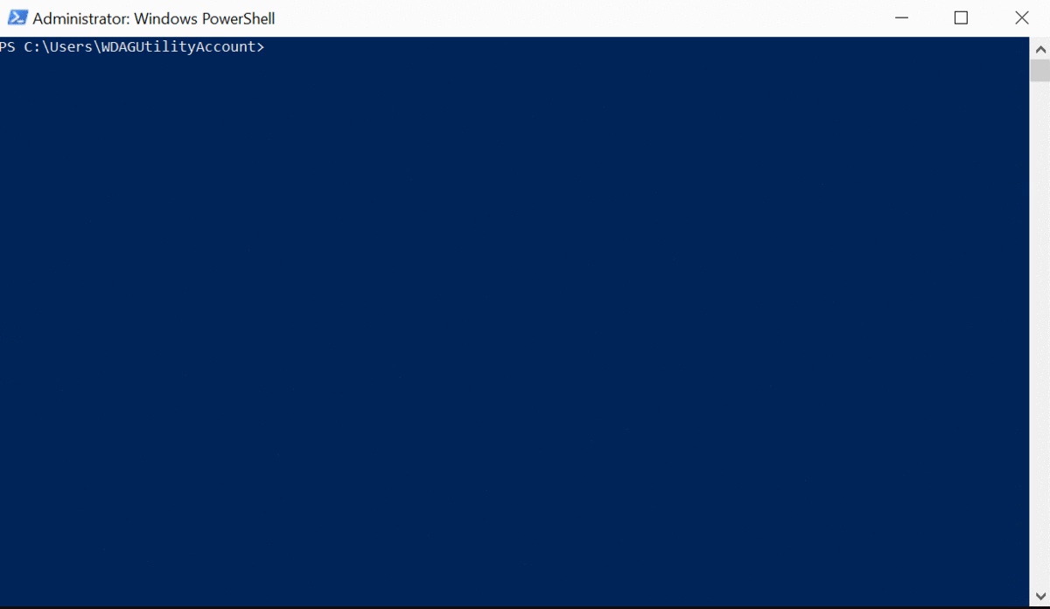
Updates

Slide 9
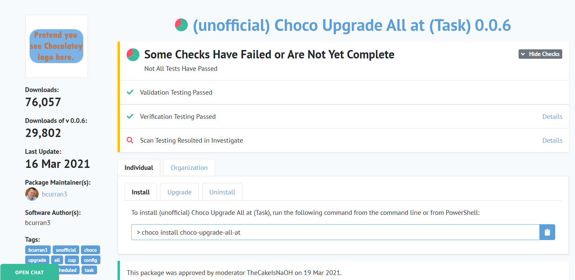
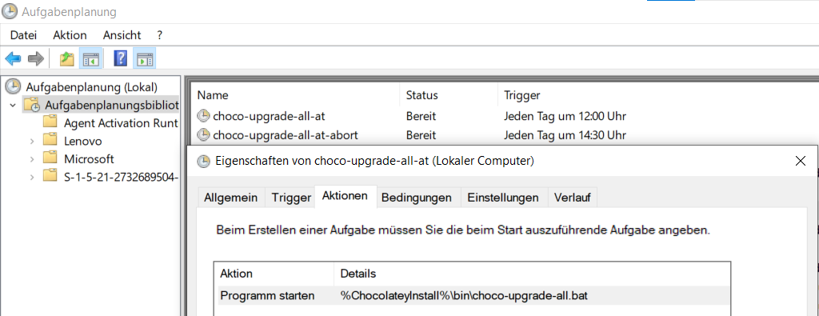
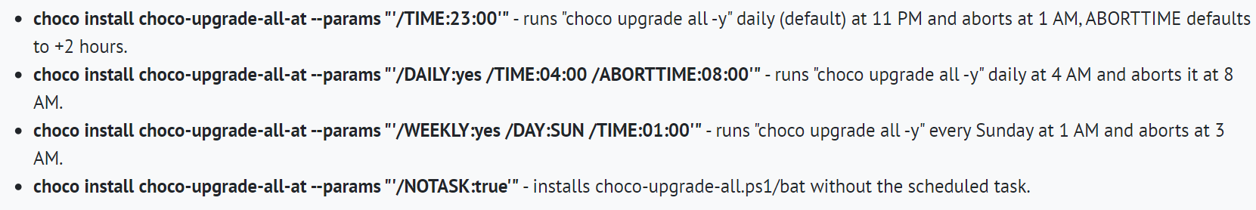
Auto updates Pro tip

Slide 10
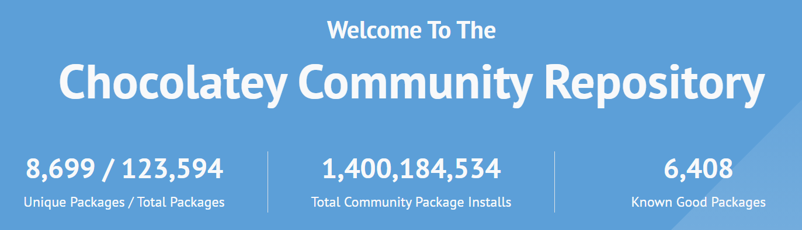
The usecase personal input
Automation of software managment
Use common tool apps in latest versions (reduction of biggest attack surface)
Integration is simple (Intune, other MDMs)
Effort is minimal

